Slide 1







_I. Introduction_
[ General information ]
- Name of project: Contact Management system.
- Purpose: This program is mainly used to record names, phone numbers, emails, and addresses.
- Users: For the organization, unit, company, hospital, school, etc.
- Scope of project: In Resource Human Management or Customer Information Management.
[ Project selection ]
The main reason I chose to do this project was to manage student information more quickly and easily
[ Main features ]
The Contact Management system program was divided into 5 parts and 5 cases:
List all contacts
2. Add new contact
3. Search contact
4. Edit contact
5.Delete contact

Slide 2


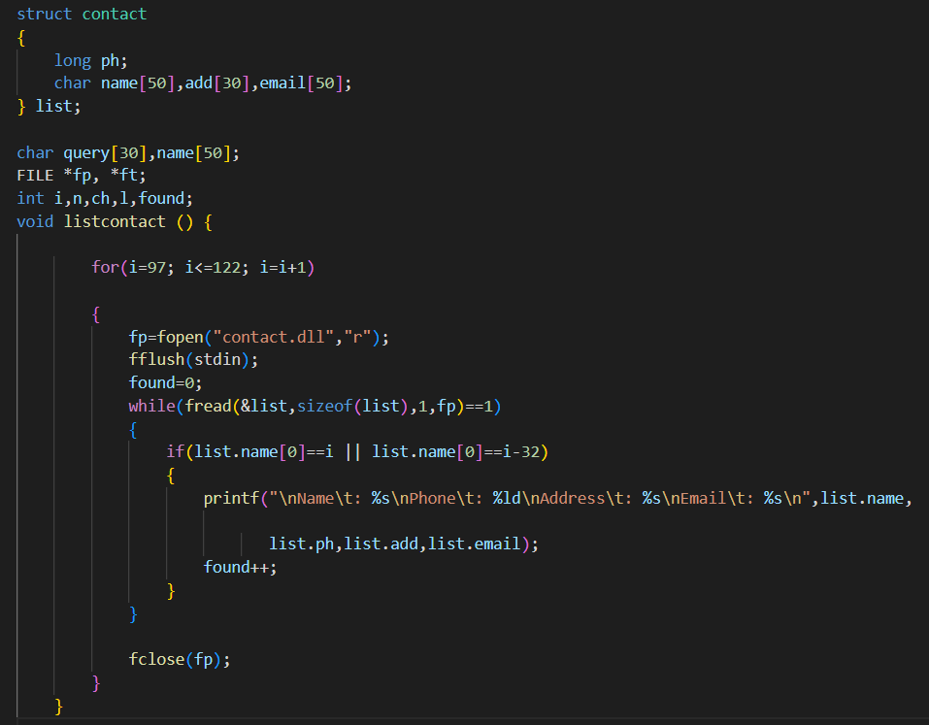


_II. Designing_
Start of main and assign contact.dll to listcontact()

Slide 3

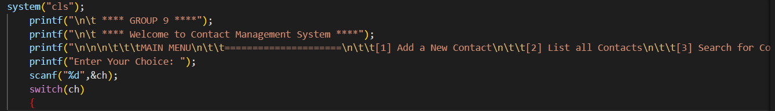

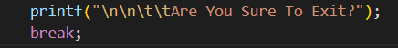
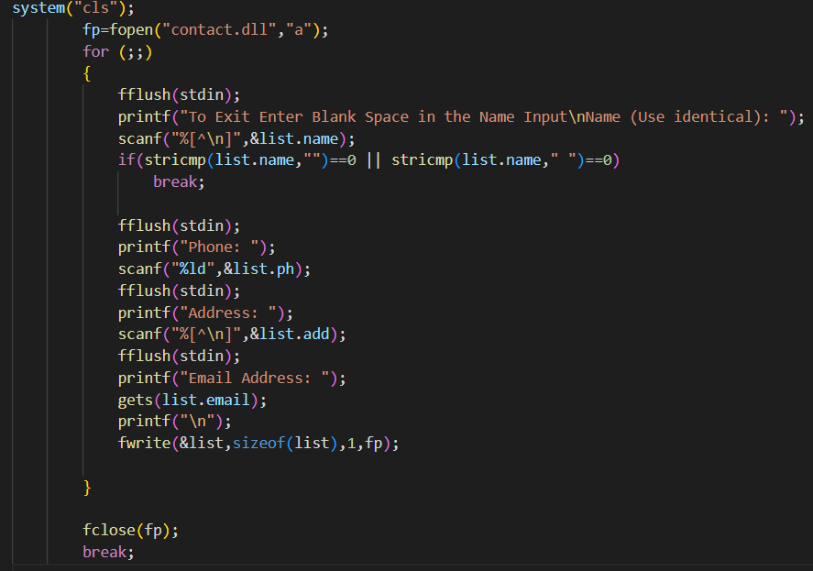

Print on-screen: Print the list of insert information, edit, delete and search
This is used for Exit
This is used for Add a new Contact

Slide 4

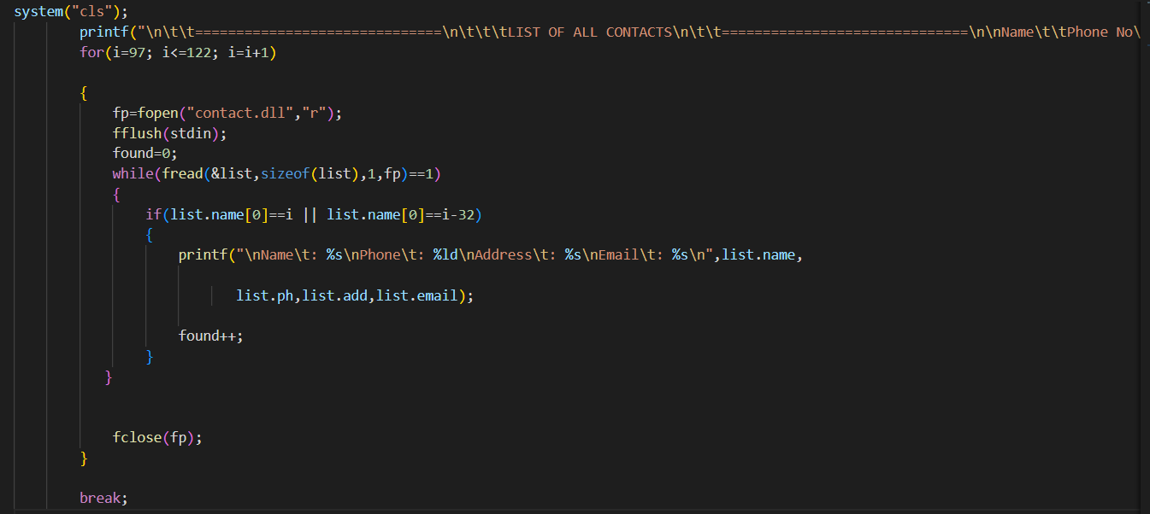



This is used to List all Contact

Slide 5

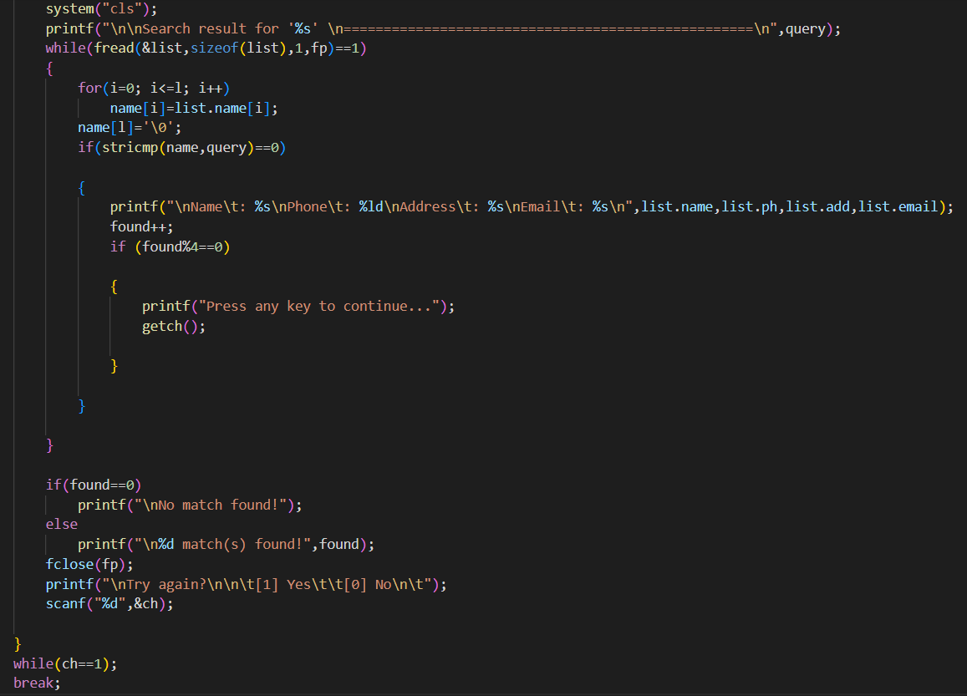


This is used search for Contact

Slide 6


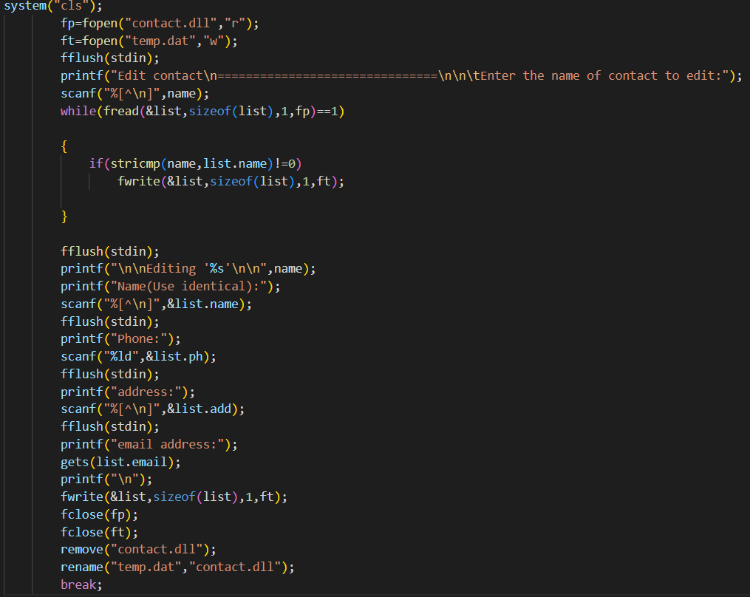



This is used for Edit a Contact

Slide 7

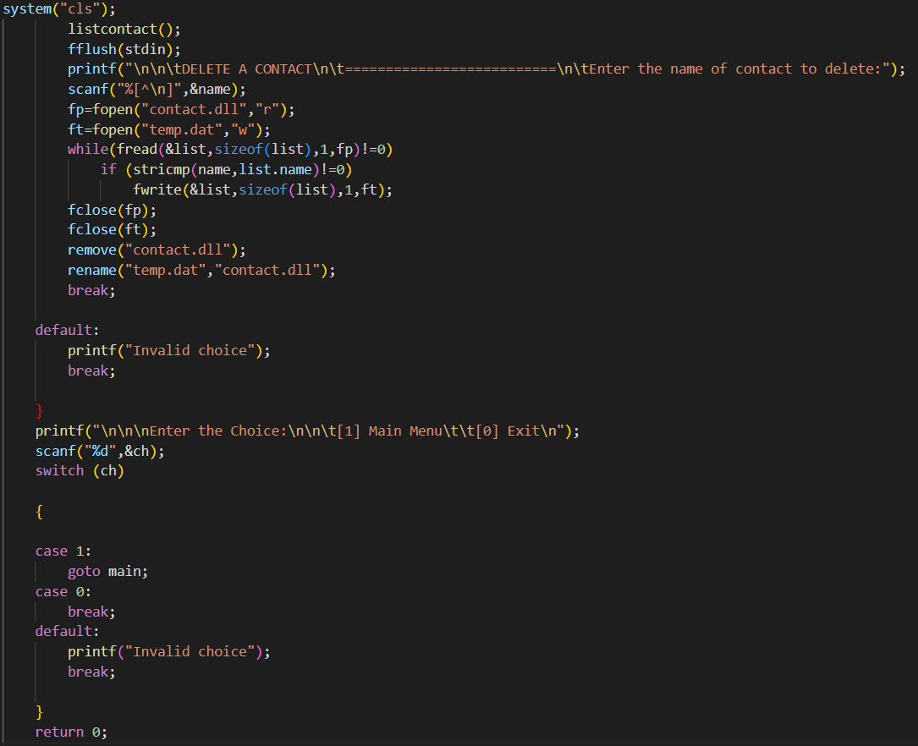




This is used for Delete a Contact

Slide 8



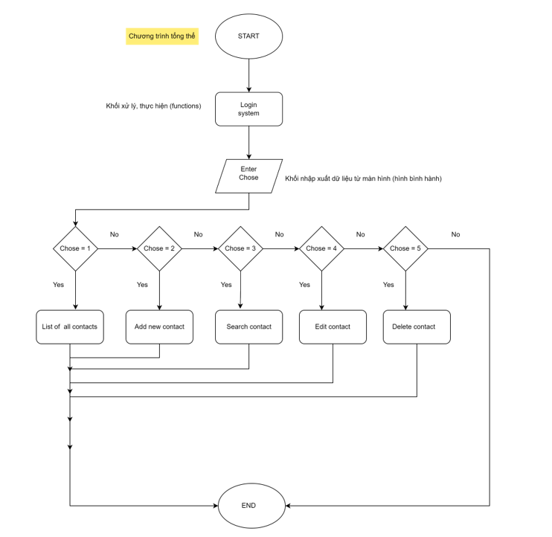

_III. Algorithms used in the project_
The key features of the contact management system are listed below:
- List – Algorithm to list all the contact in a data structure.
- Add – Algorithm to add a new contact to a data structure.
- Search − Algorithm to search contact in a data structure.
- Edit − Algorithm to update information in a data structure.
- Delete − Algorithm to delete a person from a data structure.

Slide 9







_IV. Discussion_
The limitations of my program is that not everyone can use it, there will be people who are used to working on paper and are not computer savvy; sometimes the program does not have what the School manager needs.
I will try my best to solve the limitations in future work so everyone can use our program.
_V. Conclusion_
It is based on the concept to generate Personal or an Organization’s Contact Records to add their records and update them. Users can add Contact details safely without wasting time. This System makes it easy to store records of each contact. The whole project is designed in ‘C’ language and different variables and strings have been used for the development of this project. This mini project is easy to operate and understand by the users. This is a simple mini project in C, built as a console application without using any graphics features.
The system can help you organize a person’s details by entering their information such as Phone, Name, Address, and Email. The purpose of the system is to help and maintain the management of a person’s contact information. It’s similar to how cell phones handle contacts. You can add, view, edit, search and delete contacts. You can organize your first name, last name, address, phone, and email by utilizing a data structure. File handling, data structure, functions, and pointers are the main things that make up the project.

Slide 10
Presentation of group 9 about Contact Management System
Thanks for watching
_ Ending _

